Slide 1
Android Development - II
cyberlabs

Slide 2
Objectives
Learn how to give life to the layouts created in the previous workshop – through programming
Basic concepts of Java – enough to make your desired app work as intended.

Slide 3
Languages for Android: Java, Kotlin
Easy to learn, English-like language with great community support.
Versatile languages, used for developing applications for the web, mobile as well as desktop.
Have multiple Open-Source Libraries that can be copied, studied, changed and shared.
In this workshop, we will proceed with Java, however you are free to explore both the languages.
In the hands-on coding period you will see how these concepts are used in making the dice-rolling app do what we want.

Slide 4
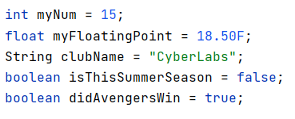
Variables and Data Types
Variables are containers for storing values.
The values fall into certain types such as
String – “Android”
int – 1, 35
float – 23.856
boolean – true, false

Slide 5
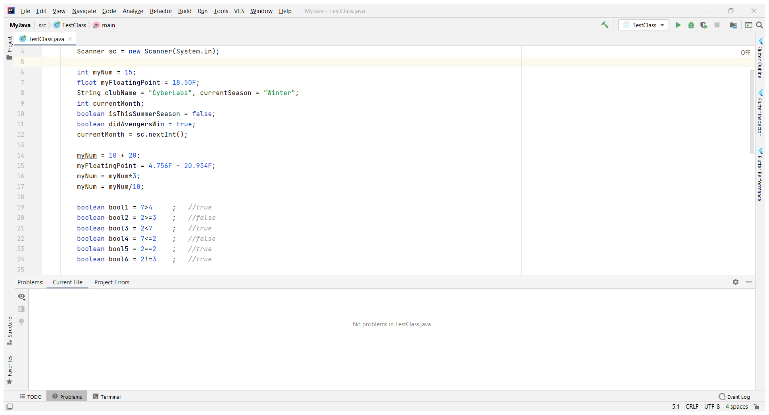
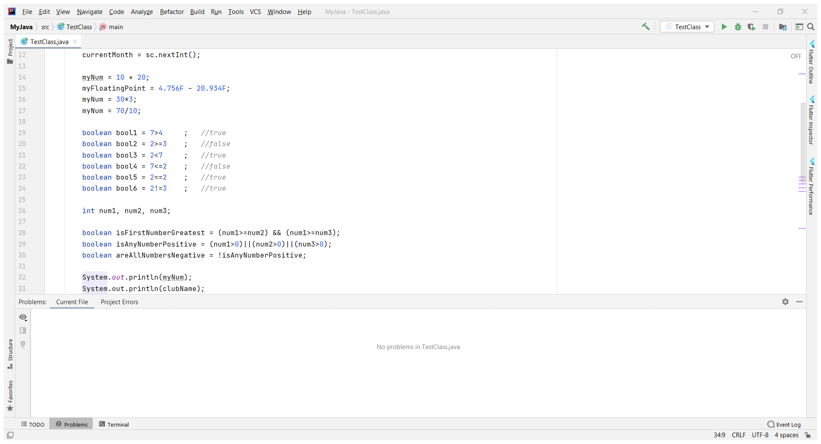
Operators
Comparison
Arithmetic
Logical

Slide 6
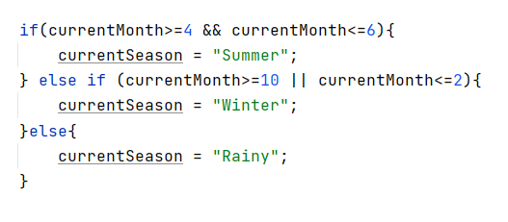
Conditional Statements
Statements that get executed if a particular condition is satisfied.

Slide 7
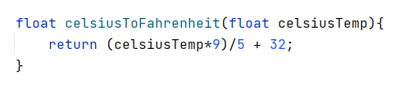
Methods
A method is a block of code which only runs when it is called.
You can pass data, known as parameters, into a method.
Methods are used to perform certain actions, and they are also known as functions.
Why use methods? To reuse code: define the code once, and use it many times.

Slide 8
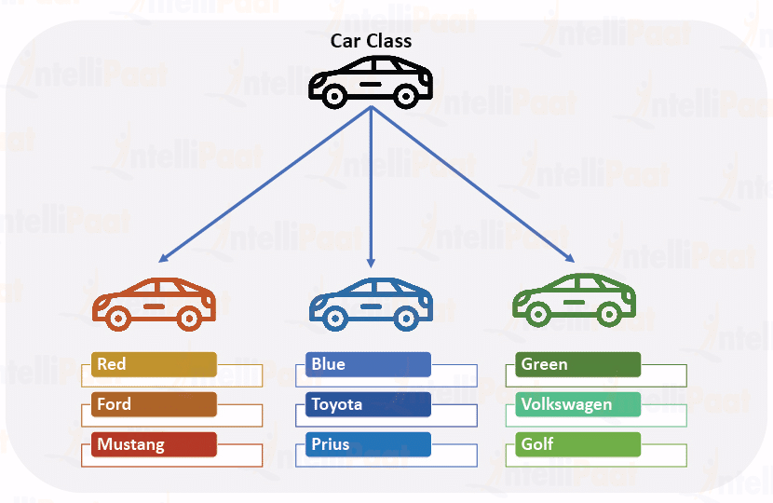
Classes and Objects
Classes and objects are basic concepts of Object Oriented Programming.
Classes are blueprints/prototypes from which objects are created.
Objects are a basic unit of Object Oriented Programming, whose properties are characterized by the classes they belong to.

Slide 9
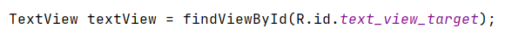

Using Objects
Class Name
An Android-specific method that binds the XML View possessing the supplied ID to the Java object
Object Name
Dot Operator

Slide 10
Object Oriented Programming
Object Oriented Programming is a way of programming characterized by four principles:
1. Abstraction: The ground-level implementation is hidden from the programmer, by reducing them to a function call.
2. Encapsulation: Data members can be hidden from direct access of the programmer, by providing publicly-accessible getter and/or setter methods as desired.
3. Inheritance: The ability to form child classes from existing parent classes, by reusing the entire code of parent classes as well as adding unique code for child classes.
4. Polymorphism: Certain methods can be given multiple implementations based on the domain or context in which the methods are used.

Slide 11
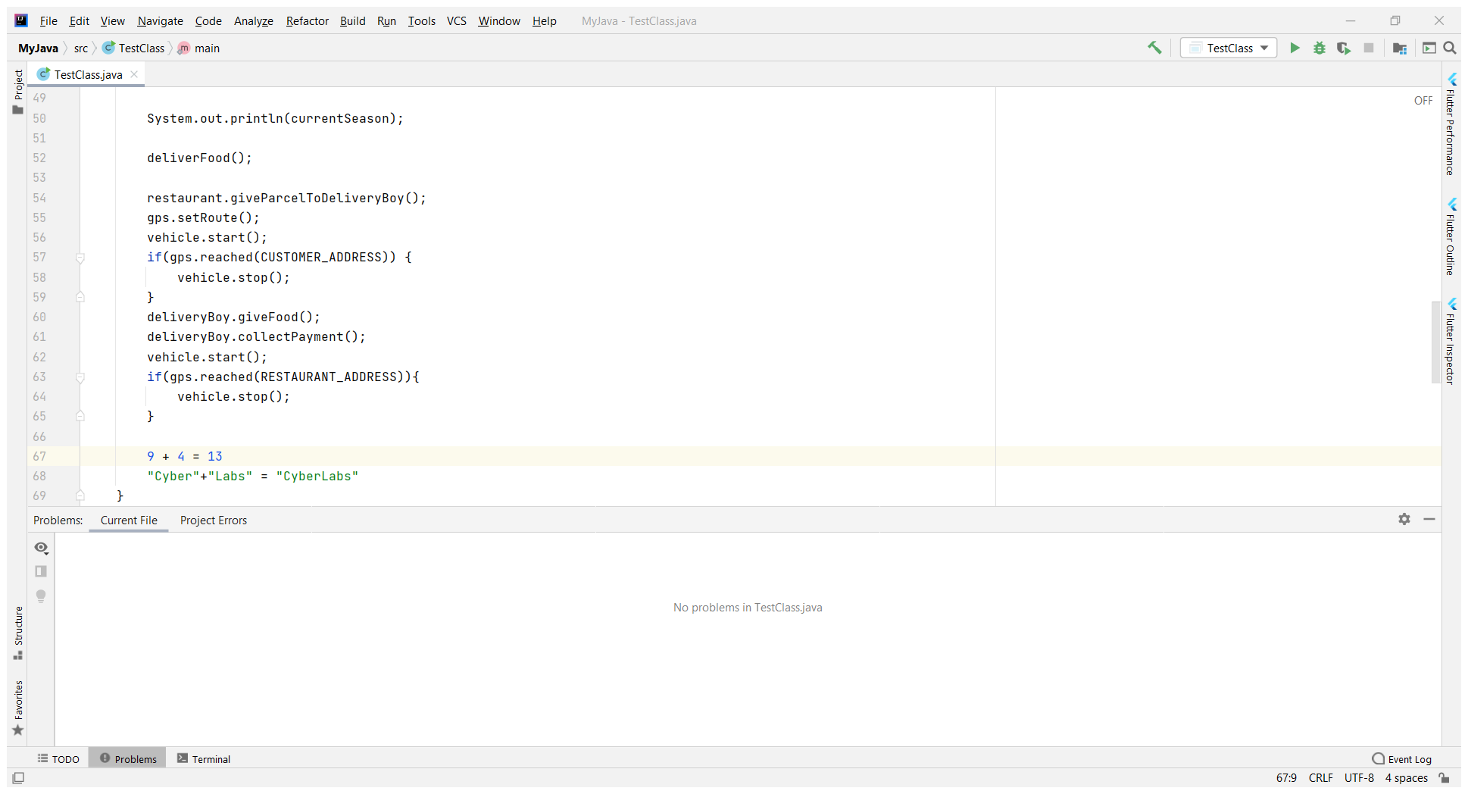
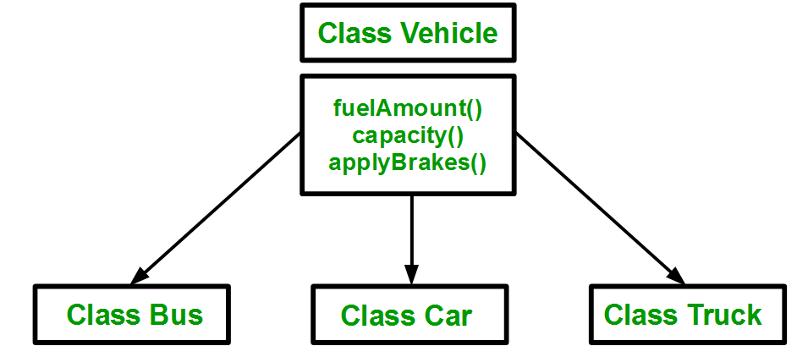
Abstraction
Inheritance

Slide 12
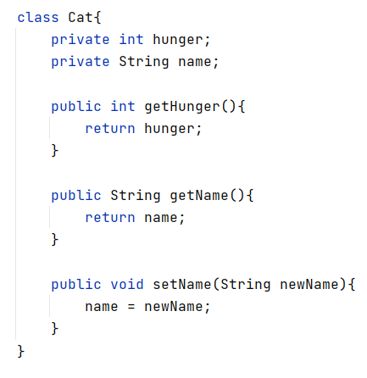
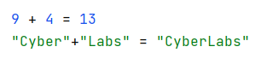
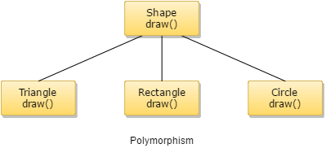
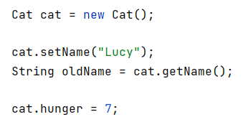
Encapsulation
Polymorphism

Slide 13
Time For Some Action…
We will complete the Dice Rolling app.

